Slide 1

Group: Midnight Kamikaze Pilots™
Members: Josh Gaston, John Carroll, Chase Counsell,
Ryon Campbell, Wan Lau

Slide 2
Outline
Introduction
Requirements
  Needs
  Features
Design and architecture
Demo
Project management
Lessons learned

Slide 3
Requirements
Where did they come from
  The requirements came from taking the problem’s nouns and verbs from the concept statement.
How did you manage them
  Prioritized users and main functions first
  Documented as we went along
  Changed requirements according to likely user scenarios

Slide 4
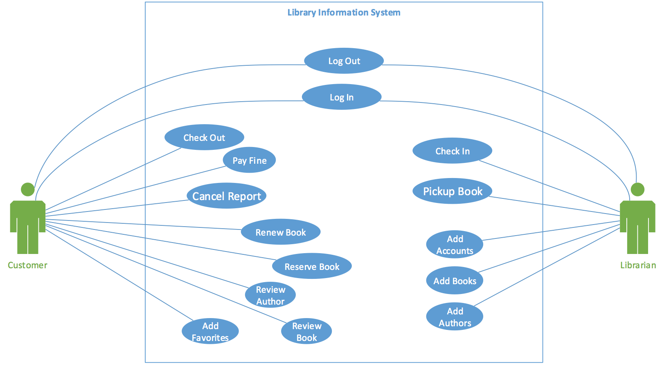
Requirements
How did you capture requirements
  Use case diagram

Slide 5
Design and architecture
Overview of your design and architecture.
  UML diagrams (deployment, class, state, collaboration)‏
  GRASP Patterns

Slide 6
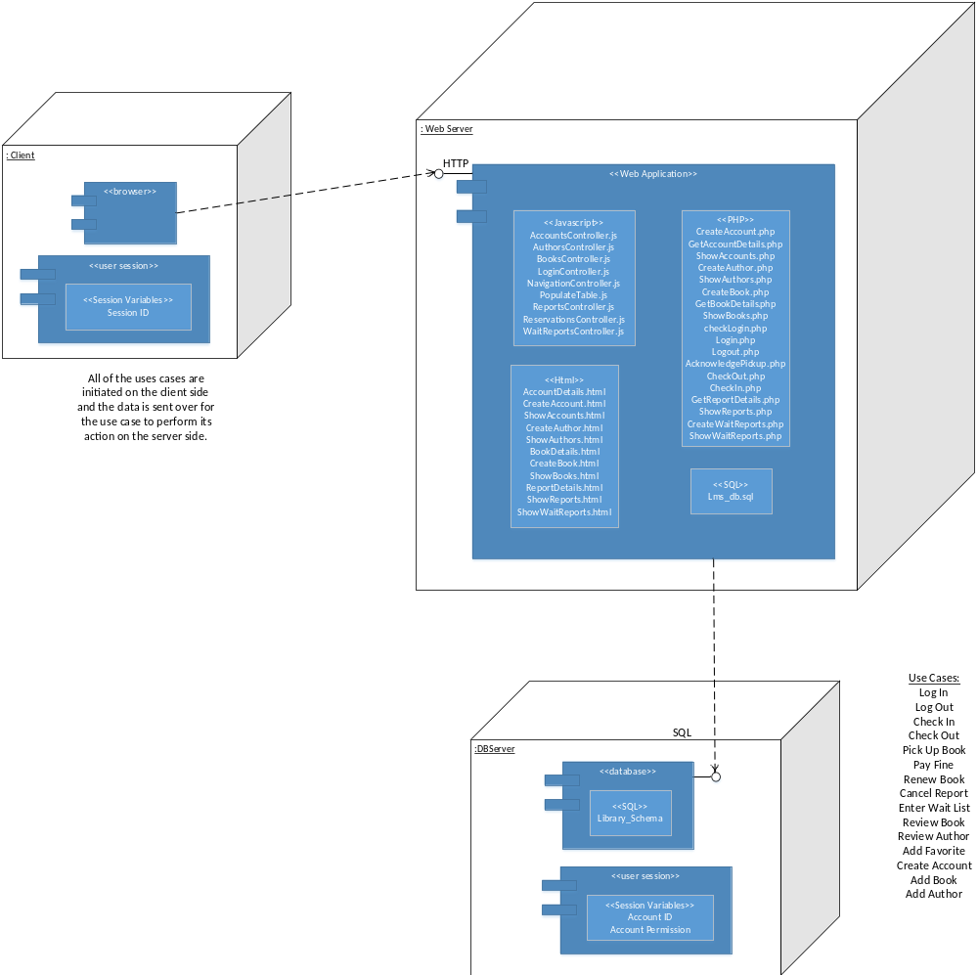
Design and architecture
Deployment Diagram

Slide 7
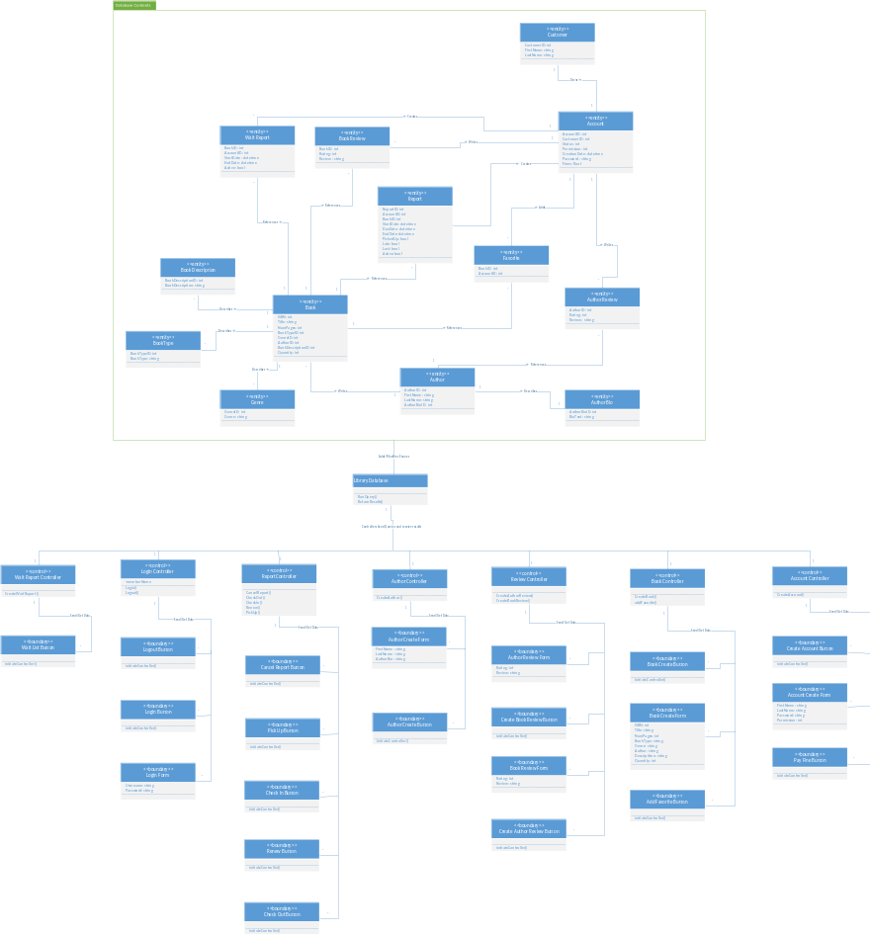
Design and architecture
Class Diagram

Slide 8
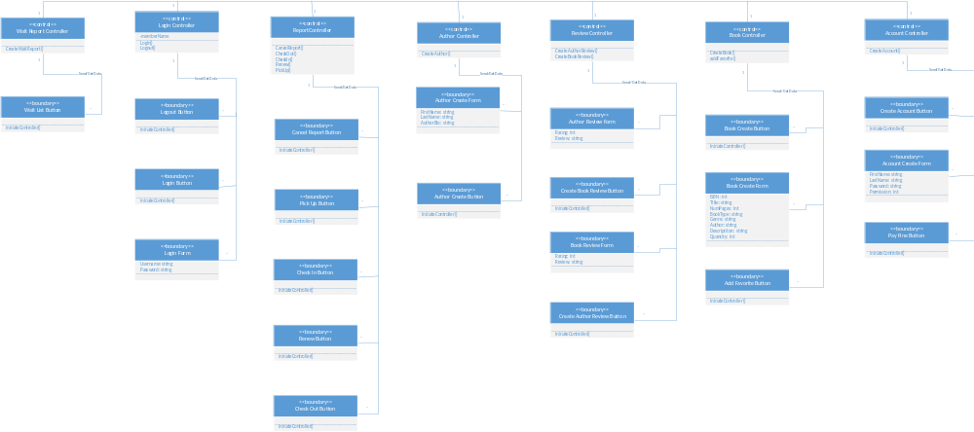
Design and architecture
Class Diagram – Front end

Slide 9
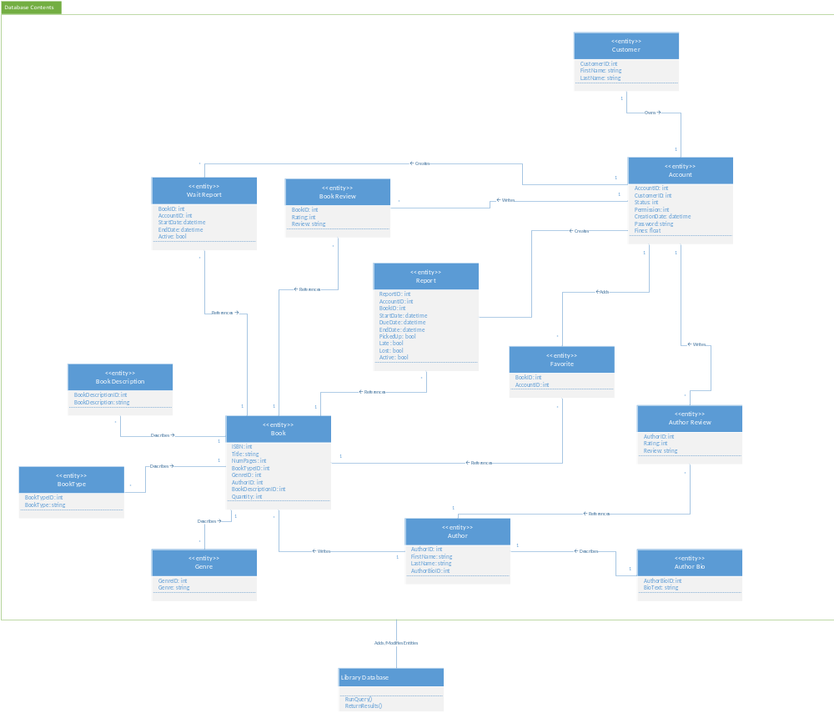
Design and architecture
Class Diagram – Back end

Slide 10
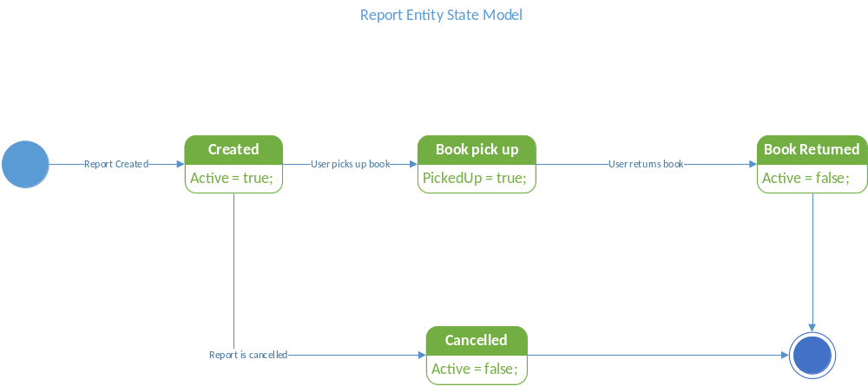
Design and architecture
State Diagrams - Report

Slide 11
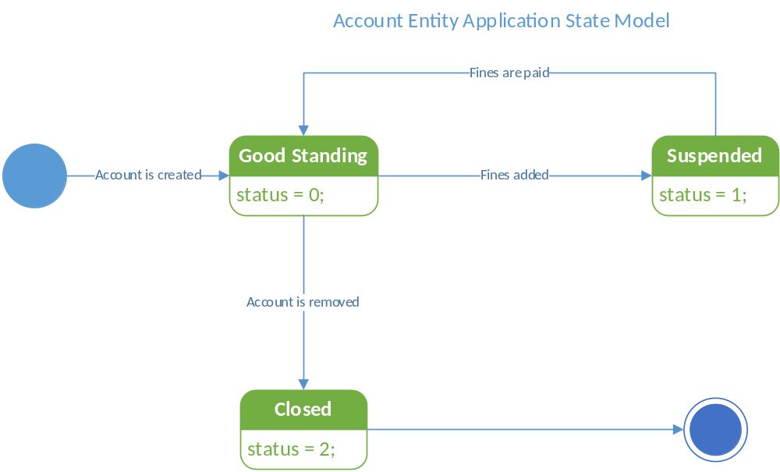
Design and architecture
State Diagrams - Account

Slide 12
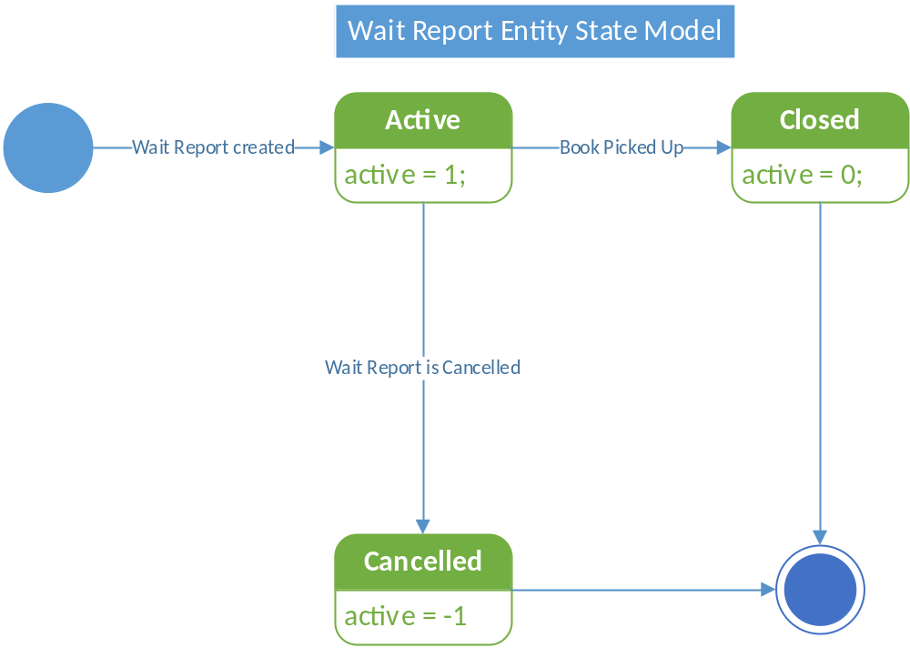
Design and architecture
State Diagrams – Wait report

Slide 13
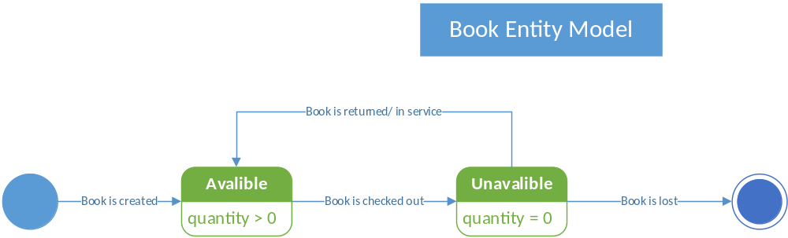
Design and architecture
State Diagrams – Book

Slide 14
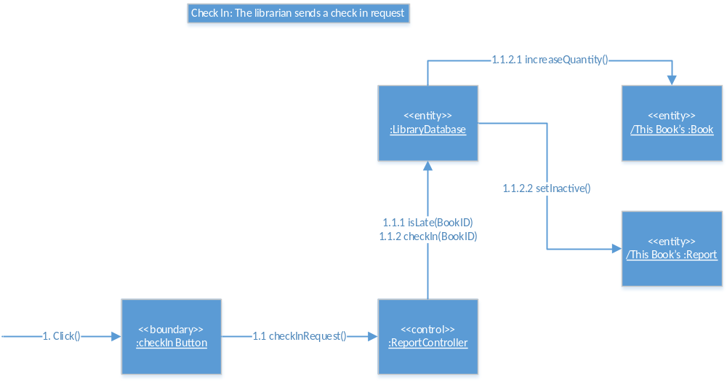
Design and architecture
Collaboration - Check In

Slide 15
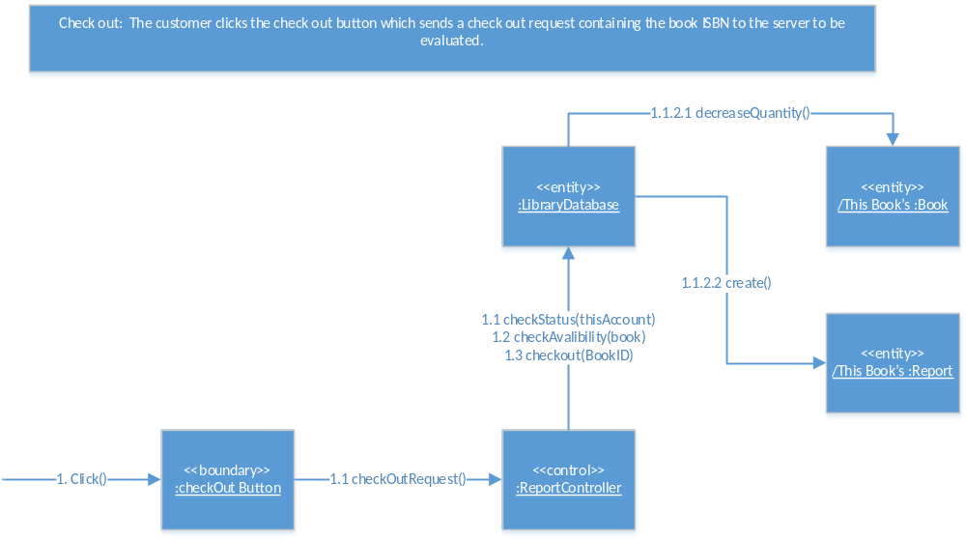
Design and architecture
Collaboration - Check Out

Slide 16
Design and architecture
GRASP Patterns
  Check In - This use case takes a controller pattern by using the Report Controller, here, the Report Controller completes the actual check in process in between the boundary and entity objects. The use case also takes on a Indirect Pattern by mediating between the boundary object (check in button) and taking the check in request and actually processing it by changing the entity objects(this Book, this book’s report) inside the Library Database, removing the need for direct contacts between boundaries and entities.
  Check out - This use case takes a controller pattern by using the Report Controller, here, the Report Controller completes the actual check-out process in between the boundary and entity objects. The use case also takes on a Indirect Pattern by mediating between the boundary object (check out button) and taking the check out request and actually processing it by changing qualities of the entity objects(this Book, this book’s report) inside the Library Database, removing the need for direct contacts between boundaries and entities. This use case however, also has a creator pattern, in which that entities (reports) can only be created from the use of a controller, and cannot be created otherwise.

Slide 17
Design and architecture
Design decisions
  What trade-offs
    We tried to keep it simple for the semester long project that it was.
  How did you address different architectural issues
    We dealt with issues as they arose.
    Maintaining consistency was a re-occurring issue.

Slide 18
Demo
http://auburn.edu/~jcg0031/

Slide 19
Project management
How did you communicate
  We communicated mostly through group chat in Facebook messenger and through text messaging
  It proved quite effective and efficient over the semester
Iterations
  1 for Analysis Phase
  1 for Design Phase

Slide 20
Project management
Roles
  Who did what (initially)
    Leader: John Carroll
    Designer: Ryon Campbell
    Architect: Chase Counsell
    Programmer: Josh Gaston
    Other: Wan Lau (Anakin)
  How did it work
    We did not actually keep to distinct roles
    Instead, we all did a little bit of everything
    Josh was the MVP and proved to be the real leader of our group

Slide 21
Project management
Plans
    We had meetings after class and online
    Planning was influenced by the general order in which the phases flowed and their individual sections
  How important were they
    It was important to follow plans and guideline and always make sure to meet the project requirements
  How useful were they
    Plans and the different phase deadlines were useful in condoning a timely workflow

Slide 22
Lessons learned
What went right
  Implementation - website
What went wrong
  Having to re-design after analysis
What would you do differently
  Go to office hours more
How good is your work
  Pretty good

